Slide 1
Searching and Hashing
Notes:
objectives
To be able to explain and implement sequential search and binary search.
To understand the idea of hashing as a search technique.
To introduce the map abstract data type.
To implement the map abstract data type using hashing.

Slide 2
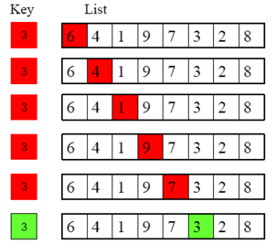
Searching
One of the most common problems that arise in computing is searching
Searching is the algorithmic process of finding a particular item in a collection of items
A search typically answers either `True` or `False` as to whether the item is present
Occasionally, the search procedure might also return the location (index) where the item is found
For our purposes here, we will simply concern ourselves with the question of membership
There are many different ways to search for the item
What we are interested in here is how these algorithms work and how they compare to one another

Slide 3

The sequential search
When data items are stored in a collection such as a list, we say that they have a linear or sequential relationship.
Each data item is stored in a position relative to the others.
In Python lists, these relative positions are the index values of the individual items.
Since these index values are ordered, it is possible for us to visit them in sequence.
This process gives rise to our first searching technique, the sequential search.
Starting at the first item in the list, we simply move from item to item, following the underlying sequential ordering until we either find what we are looking for or run out of items.
If we run out of items, we have discovered that the item we were searching for is not present.

Slide 4
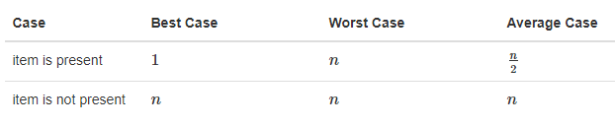
Analysis of sequential search
To analyze searching algorithms, we need to decide on a basic unit of computation.
Recall that this is typically the common step that must be repeated in order to solve the problem.
For searching, it makes sense to count the number of comparisons performed.

Slide 5

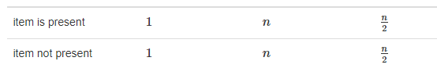
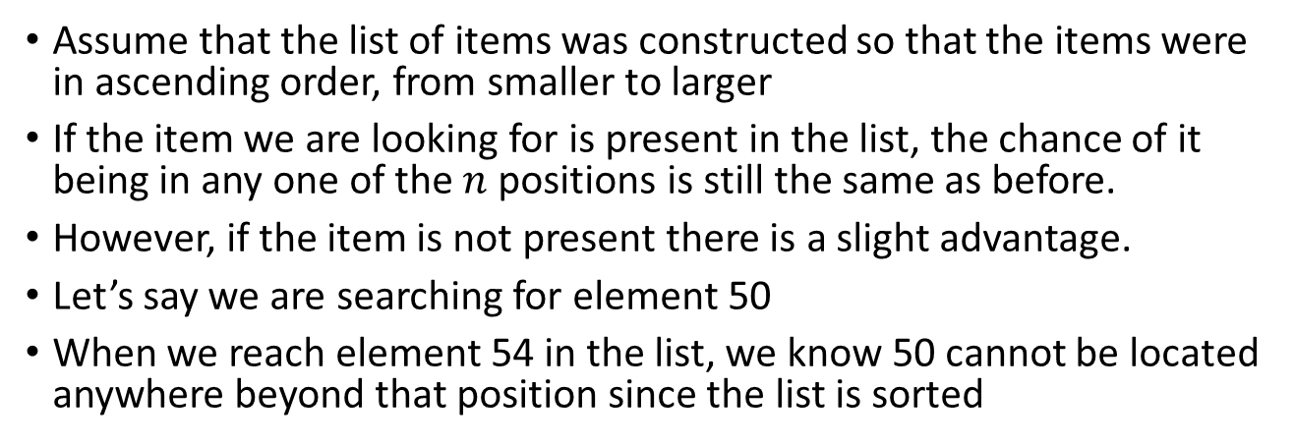
Sequential search when the list is sorted
Assume that the list of items was constructed so that the items were in ascending order, from smaller to larger
If the item we are looking for is present in the list, the chance of it being in any one of the $n$ positions is still the same as before.
However, if the item is not present there is a slight advantage.
Let’s say we are searching for element 50
When we reach element 54 in the list, we know 50 cannot be located anywhere beyond that position since the list is sorted

Slide 6
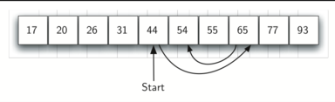
Binary search
It is possible to take greater advantage of the ordered list if we are clever with our comparisons.
Instead of searching the list in sequence, a binary search will start by examining the middle item.
If that item is the one we are searching for, we are done.
If it is not the correct item, we can use the ordered nature of the list to eliminate half of the remaining items

Slide 7
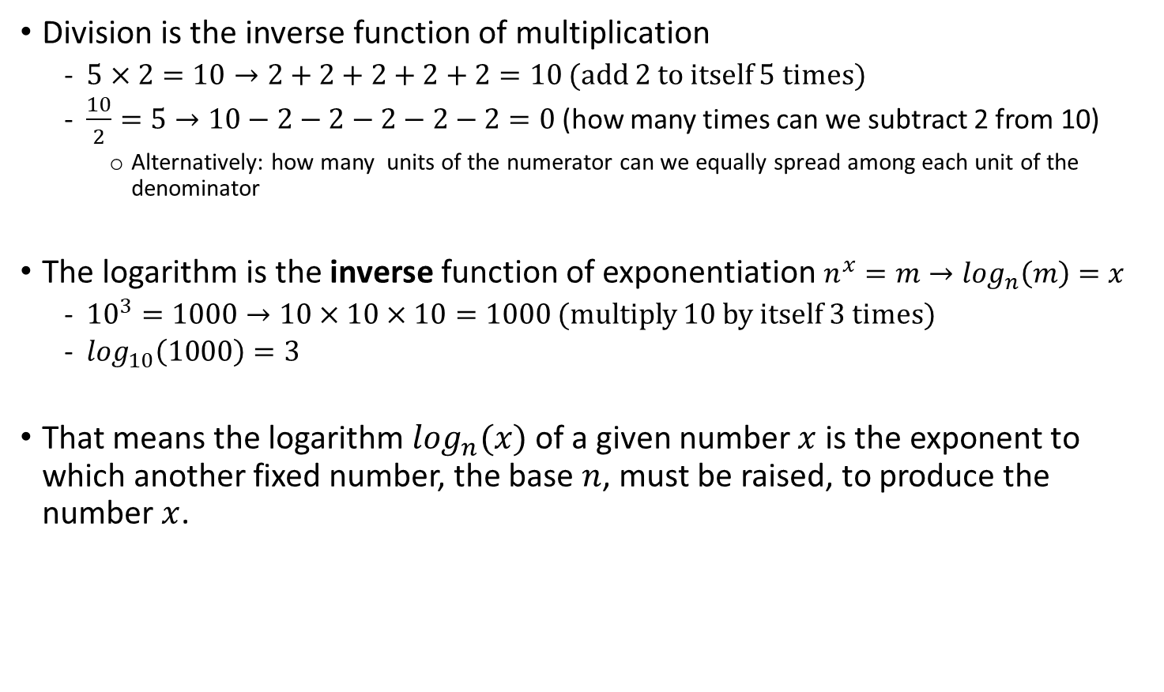
A word about logarithms
Division is the inverse function of multiplication
$5×2=10→2+2+2+2+2=10$ (add 2 to itself 5 times)
$\frac{10}{2}=5→10−2−2−2−2−2=0$ (how many times can we subtract 2 from 10)
Alternatively: how many units of the numerator can we equally spread among each unit of the denominator
The logarithm is the inverse function of exponentiation $n^{x}=m→\log_{n}\left(m\right)=x$
${10}^{3}=1000→10×10×10=1000$ (multiply 10 by itself 3 times)
$\log_{10}\left(1000\right)=3$
That means the logarithm $\log_{n}(x)$ of a given number $x$ is the exponent to which another fixed number, the base $n$, must be raised, to produce the number $x$.

Slide 8
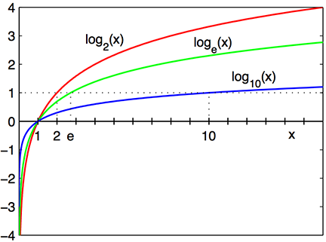
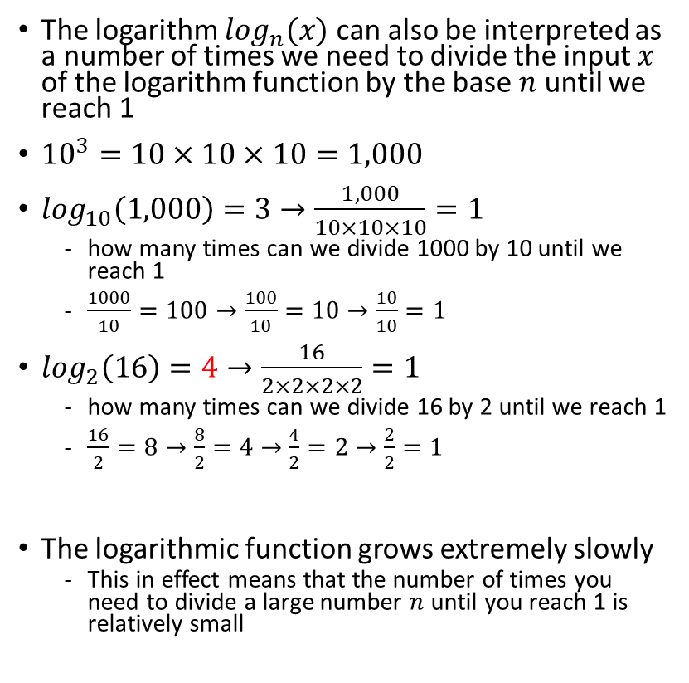
An alternative interpretation of logarithms
The logarithm $\log_{n}(x)$ can also be interpreted as a number of times we need to divide the input $x$ of the logarithm function by the base $n$ until we reach 1
${10}^{3}=10×10×10=1,000$
$\log_{10}\left(1,000\right)=3→\frac{1,000}{10×10×10}=1$
how many times can we divide 1000 by 10 until we reach 1
$\frac{1000}{10}=100→\frac{100}{10}=10→\frac{10}{10}=1$
$\log_{2}\left(16\right)=4→\frac{16}{2×2×2×2}=1$
how many times can we divide 16 by 2 until we reach 1
$\frac{16}{2}=8→\frac{8}{2}=4→\frac{4}{2}=2→\frac{2}{2}=1$
The logarithmic function grows extremely slowly
This in effect means that the number of times you need to divide a large number $n$ until you reach 1 is relatively small

Slide 9
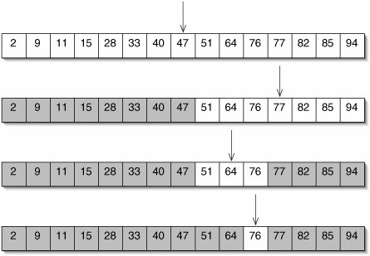
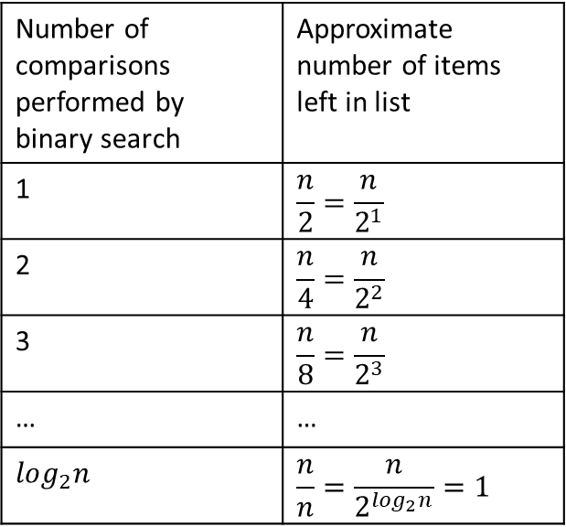
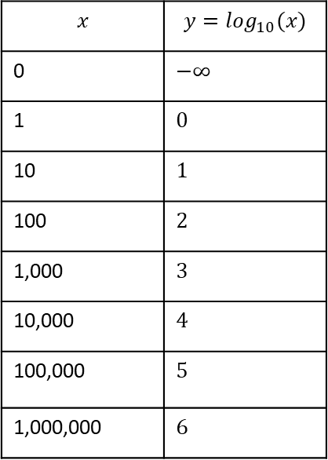
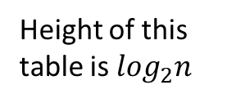
Analysis of binary search
$$x$$ | $$y=\log_{10}⁡(x)$$
0 | $$−∞$$
1 | $$0$$
10 | $$1$$
100 | $$2$$
1,000 | $$3$$
10,000 | $$4$$
100,000 | $$5$$
1,000,000 | $$6$$
Number of comparisons performed by binary search | Approximate number of items left in list
1 | $$\frac{n}{2}=\frac{n}{2^{1}}$$
2 | $$\frac{n}{4}=\frac{n}{2^{2}}$$
3 | $$\frac{n}{8}=\frac{n}{2^{3}}$$
… | …
$$\log_{2}n$$ | $$\frac{n}{n}=\frac{n}{2^{\log_{2}n}}=1$$
Height of this table is $\log_{2}n$
Notes:
The logarithmic function has a huge dampening effect for large values of x

Slide 10
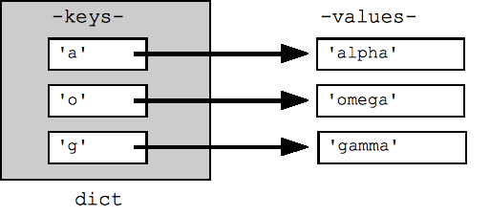
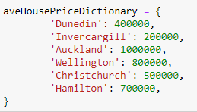
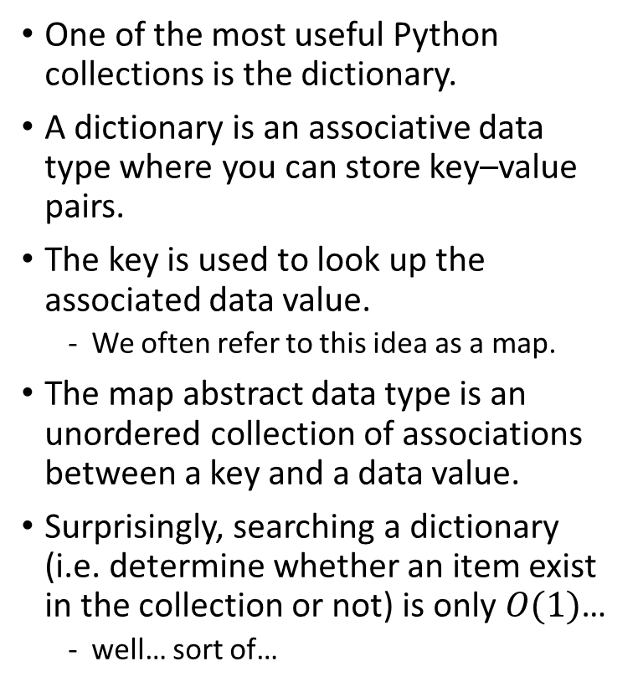
The Map Abstract Data Type
One of the most useful Python collections is the dictionary.
A dictionary is an associative data type where you can store key–value pairs.
The key is used to look up the associated data value.
We often refer to this idea as a map.
The map abstract data type is an unordered collection of associations between a key and a data value.
Surprisingly, searching a dictionary (i.e. determine whether an item exist in the collection or not) is only $O(1)$…
well… sort of…

Slide 11
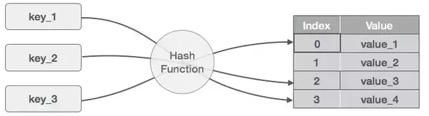
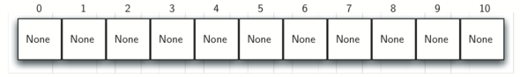
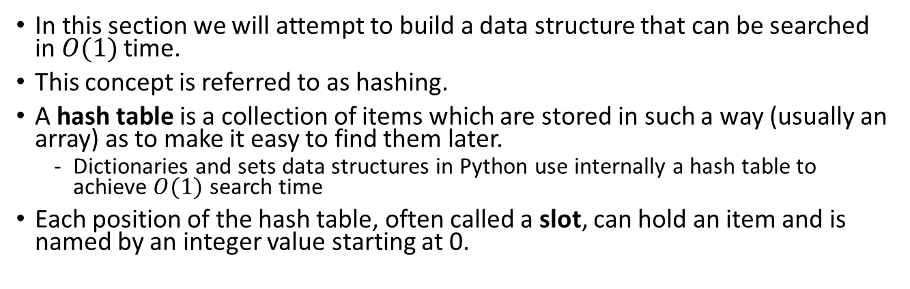
Hashing
In this section we will attempt to build a data structure that can be searched in $O(1)$ time.
This concept is referred to as hashing.
A hash table is a collection of items which are stored in such a way (usually an array) as to make it easy to find them later.
Dictionaries and sets data structures in Python use internally a hash table to achieve $O(1)$ search time
Each position of the hash table, often called a slot, can hold an item and is named by an integer value starting at 0.
Index
Value

Slide 12
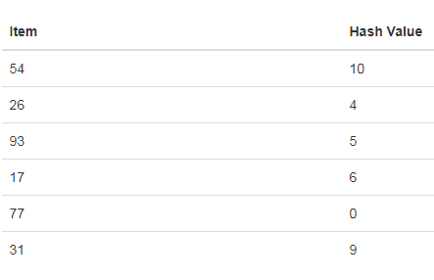
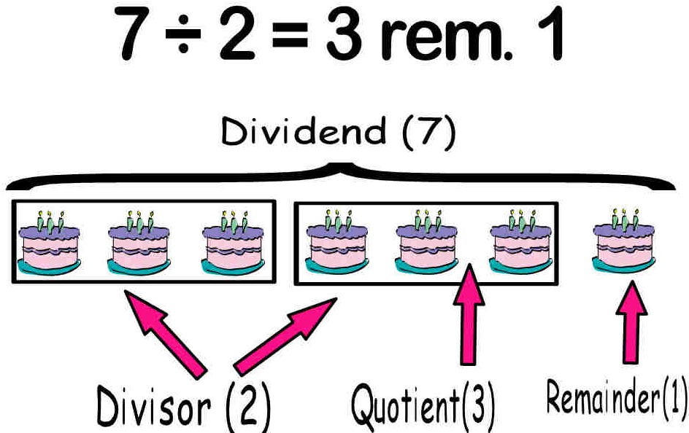
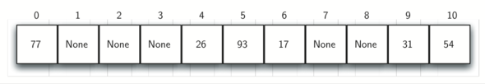
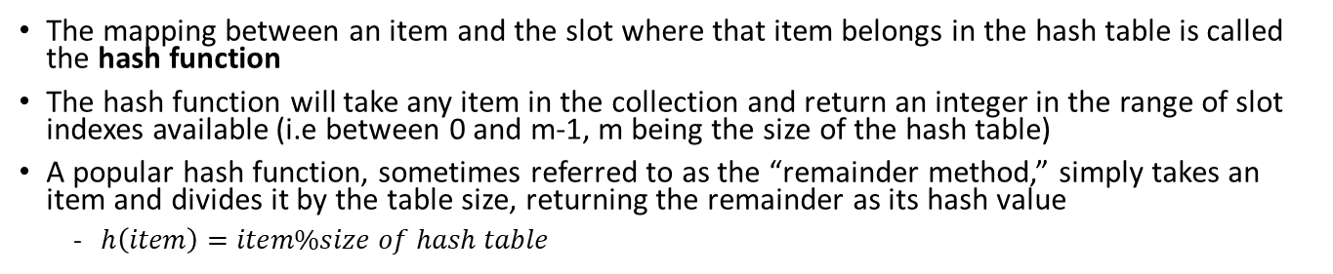
Hash function
The mapping between an item and the slot where that item belongs in the hash table is called the hash function
The hash function will take any item in the collection and return an integer in the range of slot indexes available (i.e between 0 and m-1, m being the size of the hash table)
A popular hash function, sometimes referred to as the “remainder method,” simply takes an item and divides it by the table size, returning the remainder as its hash value
$h\left(item\right)=item\%size of hash table$

Slide 13
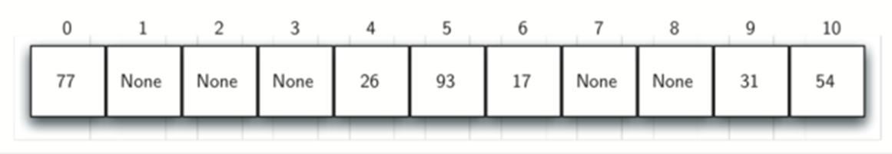
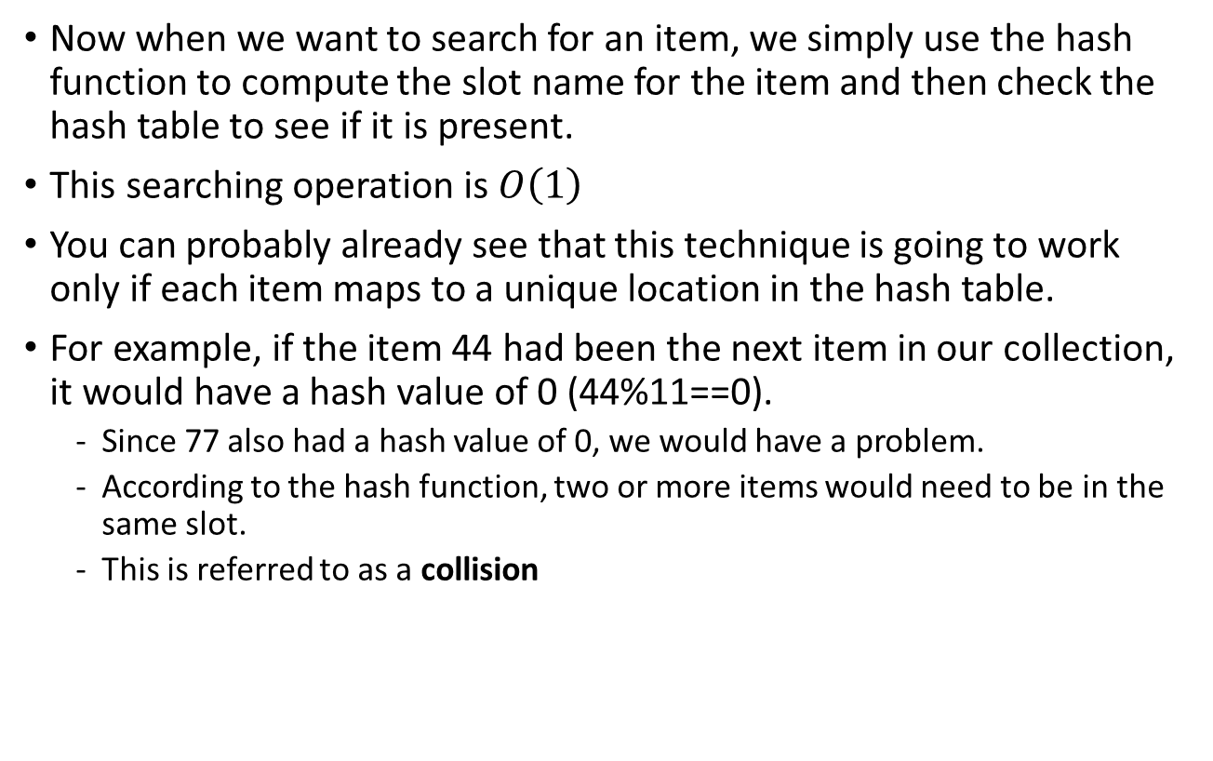
Collisions
Now when we want to search for an item, we simply use the hash function to compute the slot name for the item and then check the hash table to see if it is present.
This searching operation is $O\left(1\right)$
You can probably already see that this technique is going to work only if each item maps to a unique location in the hash table.
For example, if the item 44 had been the next item in our collection, it would have a hash value of 0 (44%11==0).
Since 77 also had a hash value of 0, we would have a problem.
According to the hash function, two or more items would need to be in the same slot.
This is referred to as a collision

Slide 14
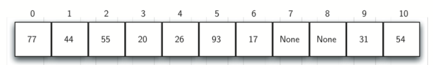
Collision resolution
When two items hash to the same slot, we must have a systematic method for placing the second item in the hash table.
This process is called collision resolution.
One method for resolving collisions looks into the hash table and tries to find another open slot to hold the item that caused the collision.
A simple way to do this is to start at the original hash value position and then move in a sequential manner through the slots until we encounter the first slot that is empty
Hash table for list(54,26,93,17,77,31
Inserting the following elements in Hash table: 44, 55, 20
44%11=0

Slide 15
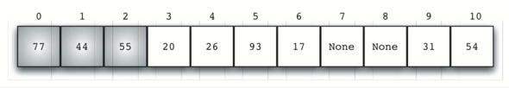
Collision resolution – linear probing and the problem with clustering
Once we have built a hash table using open addressing and linear probing, it is essential that we utilize the same methods to search for items.
Assume we want to look up the item 93. When we compute the hash value, we get 5. Looking in slot 5 reveals 93, and we can return True.
What if we are looking for 20? Now the hash value is 9, and slot 9 is currently holding 31.
We cannot simply return False since we know that there could have been collisions.
We are now forced to do a sequential search, starting at position 10, looking until either we find the item 20 or we find an empty slot.
A disadvantage to linear probing is the tendency for clustering
items become clustered in the table.
This means that if many collisions occur at the same hash value, a number of surrounding slots will be filled by the linear probing resolution.
This will have an impact on other items that are being inserted

Slide 16
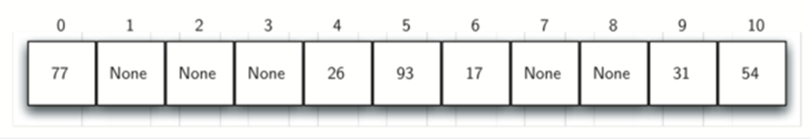
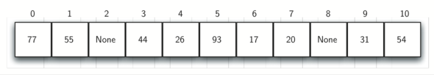

Collision resolution - rehashing
One way to deal with clustering is to extend the linear probing technique so that instead of looking sequentially for the next open slot, we skip slots, thereby more evenly distributing the items that have caused collisions.
This technique is called rehashing
This will potentially reduce the clustering that occurs.
The figure below shows the items when collision resolution is done with a “plus 3” probe.
This means that once a collision occurs, we will look at every third slot until we find one that is empty.
Plus 1 probe
Inserting the following elements in Hash table:
44, 55, 20
$$44\%11=0$$
Plus 3 probe

Slide 17
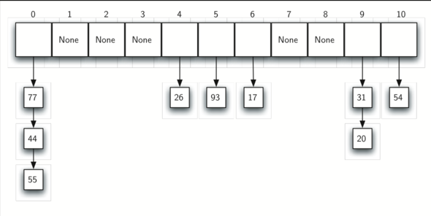
Collision resolution: chaining
An alternative method for handling the collision problem is to allow each slot to hold a reference to a collection (or chain) of items.
Chaining allows many items to exist at the same location in the hash table.
When collisions happen, the item is still placed in the proper slot of the hash table.
As more and more items hash to the same location, the difficulty of searching for the item in the collection increases

Slide 18


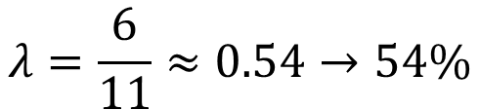
Mitigating chances of collision by monitoring the Hash table load factor $λ$
The load factor is a measure of how full the hash table is
The load factor is often used to determine how full the hash table is allowed to get before its capacity is automatically increased
$λ=\frac{number of items in hash table}{table size}$
$$λ=\frac{6}{11}≈0.54→54\%$$

Slide 19
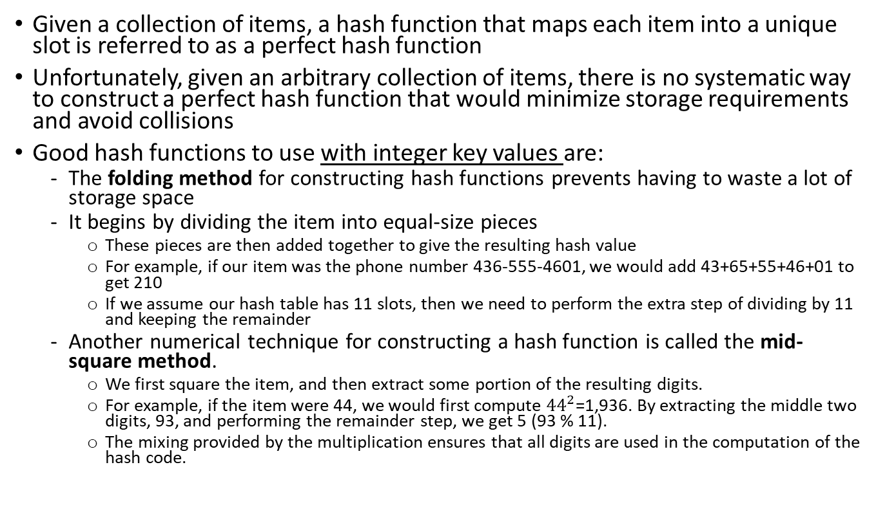
Hash functions
Given a collection of items, a hash function that maps each item into a unique slot is referred to as a perfect hash function
Unfortunately, given an arbitrary collection of items, there is no systematic way to construct a perfect hash function that would minimize storage requirements and avoid collisions
Good hash functions to use with integer key values are:
The folding method for constructing hash functions prevents having to waste a lot of storage space
It begins by dividing the item into equal-size pieces
These pieces are then added together to give the resulting hash value
For example, if our item was the phone number 436-555-4601, we would add 43+65+55+46+01 to get 210
If we assume our hash table has 11 slots, then we need to perform the extra step of dividing by 11 and keeping the remainder
Another numerical technique for constructing a hash function is called the mid-square method.
We first square the item, and then extract some portion of the resulting digits.
For example, if the item were 44, we would first compute ${44}^{2}$=1,936. By extracting the middle two digits, 93, and performing the remainder step, we get 5 (93 % 11).
The mixing provided by the multiplication ensures that all digits are used in the computation of the hash code.

Slide 20
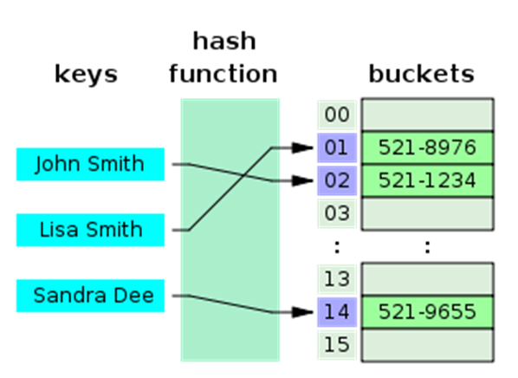
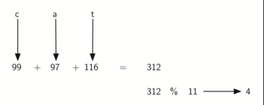
Hash functions for character-based items such as strings
We can also create hash functions for character-based items such as strings.
The word “cat” can be thought of as a sequence of ordinal values
The ordinal values can be derived from the Unicode code point for a one-character string
We can then take these three ordinal values, add them up, and use the remainder method to get a hash value
ord('c')
ord('a')
ord('t')

Slide 21
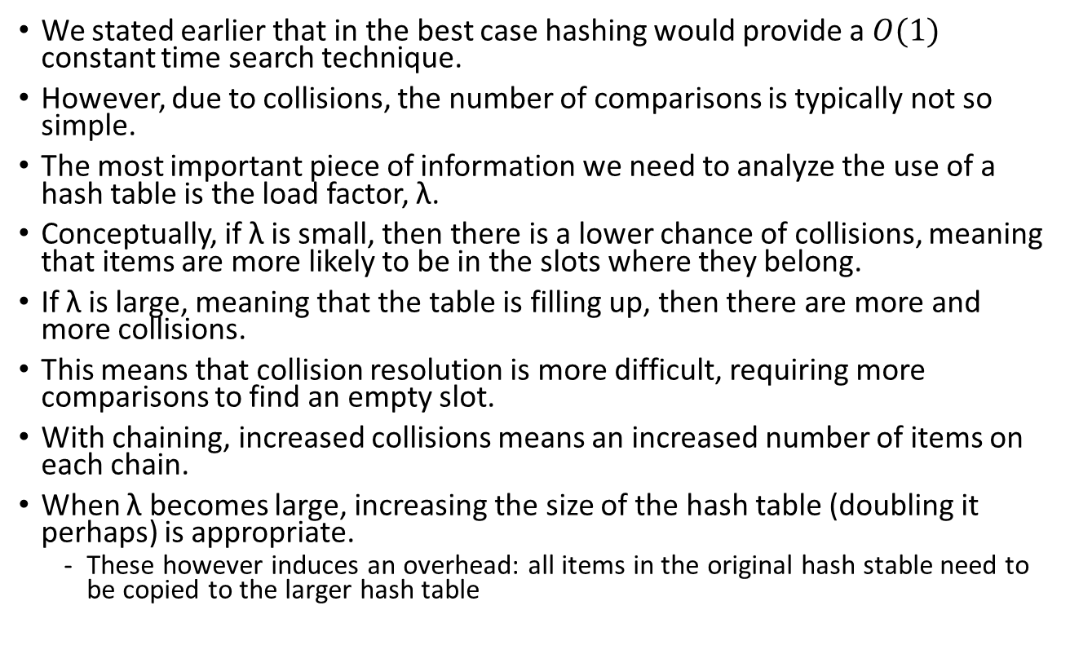
Analysis of Hashing
We stated earlier that in the best case hashing would provide a $O(1)$ constant time search technique.
However, due to collisions, the number of comparisons is typically not so simple.
The most important piece of information we need to analyze the use of a hash table is the load factor, λ.
Conceptually, if λ is small, then there is a lower chance of collisions, meaning that items are more likely to be in the slots where they belong.
If λ is large, meaning that the table is filling up, then there are more and more collisions.
This means that collision resolution is more difficult, requiring more comparisons to find an empty slot.
With chaining, increased collisions means an increased number of items on each chain.
When λ becomes large, increasing the size of the hash table (doubling it perhaps) is appropriate.
These however induces an overhead: all items in the original hash stable need to be copied to the larger hash table

Slide 22
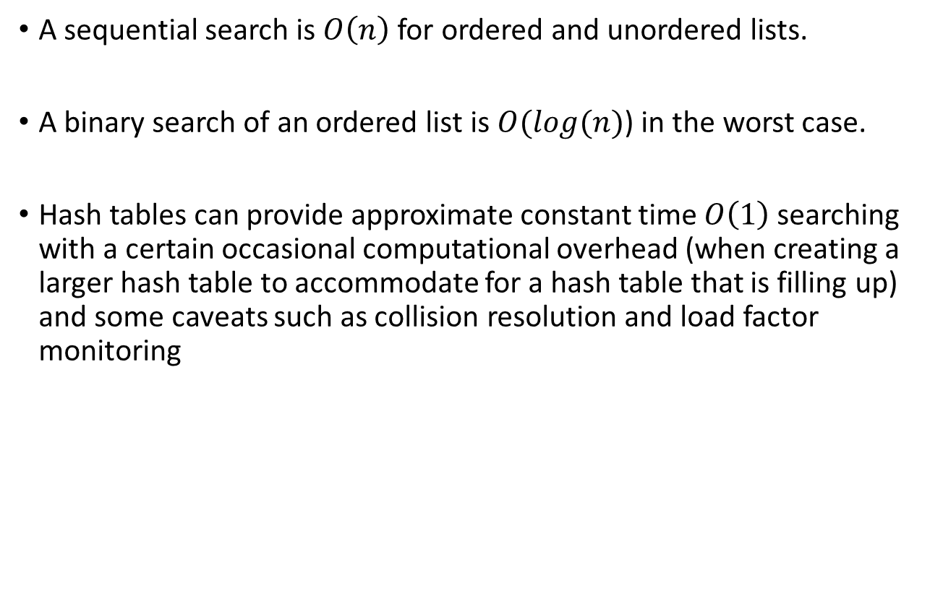
Summary
A sequential search is $O\left(n\right)$ for ordered and unordered lists.
A binary search of an ordered list is $O(log(n)$) in the worst case.
Hash tables can provide approximate constant time $O\left(1\right)$ searching with a certain occasional computational overhead (when creating a larger hash table to accommodate for a hash table that is filling up) and some caveats such as collision resolution and load factor monitoring

